Slide 1
6-DoF Semantics-Aware Condition- and Viewpoint-Invariant Visual SLAM
Confirmation of Candidature
Sourav Garg
Principal Supervisor : Michael Milford
Associate Supervisor: Niko Sunderhauf

Slide 2
Contents
Introduction
Literature Review
Research Questions
Research Plan
Work Progress
Research Timeline

Slide 3
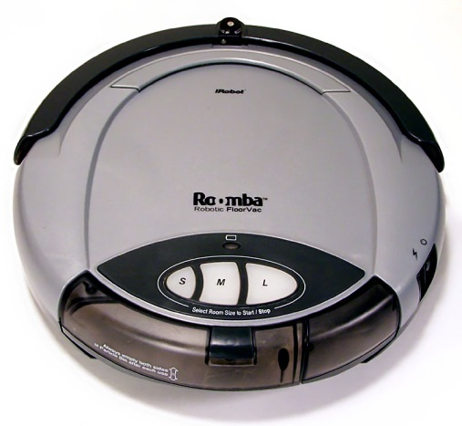
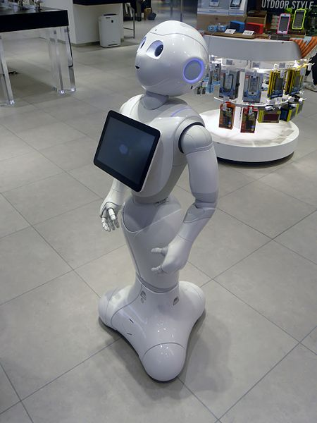
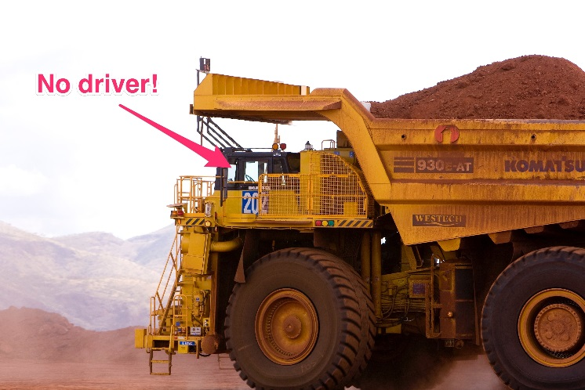
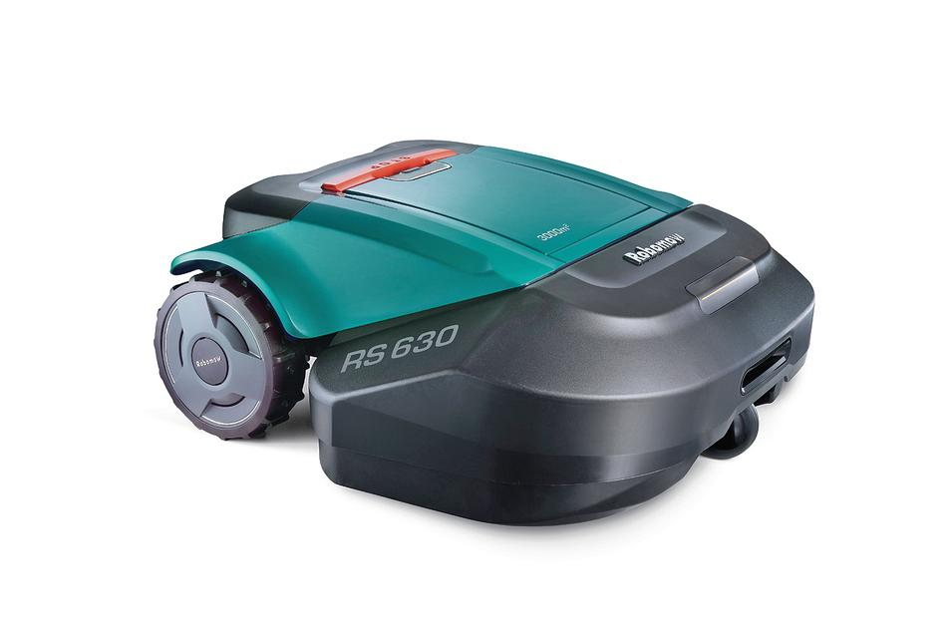
Introduction
Social [1]
Domestic [2,3]
Industrial [4]
https://en.wikipedia.org/wiki/Pepper_(robot)#/media/File:SoftBank_pepper.JPG
Larry D. Moore CC BY-SA 3.0 -https://en.wikipedia.org/wiki/Domestic_robot#/media/File:Roomba_original.jpg
http://www.robotshop.com/en/robomow-rs622-robot-lawn-mower.html
https://www.businessinsider.com.au/rio-tinto-using-self-driving-trucks-to-transport-ore-2015-10?r=UK&IR=T

Slide 4

SLAM
Simultaneous Localization and Mapping
Landmarks in Environment
Robot Pose
Approach
Using Sensors like Laser Ranger
Alternative:
Camera
Information-Rich
Easy Access
Inexpensive
Visual SLAM
ORB-SLAM2 - https://youtu.be/ufvPS5wJAx0

Slide 5
Visual SLAM
Optimization
Visual Place Recognition
Visual Odometry
Representation Map

Slide 6
Visual SLAM
Optimization
Visual Place Recognition
Visual Odometry
Representation Map

Slide 7
Visual Place Recognition
Place Representation
Local Features – SIFT, SURF, ORB etc.
Bag of Words in FAB-MAP, ORB-SLAM etc.
Global Representation – ConvNet, HoG etc.
Direct Matching in LSD-SLAM, SeqSLAM etc.

Slide 8
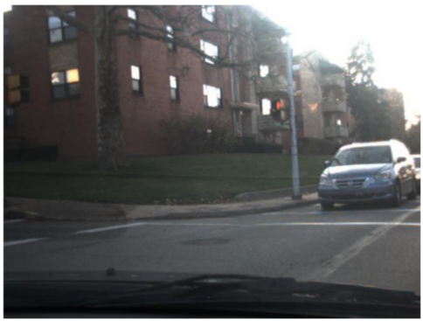
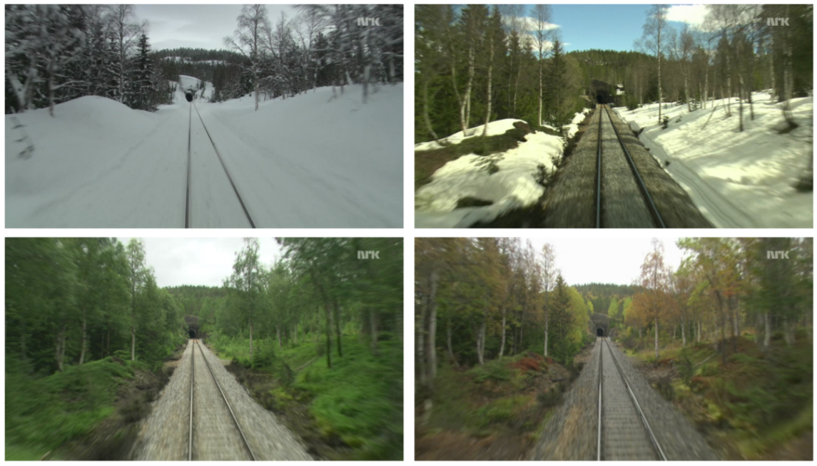
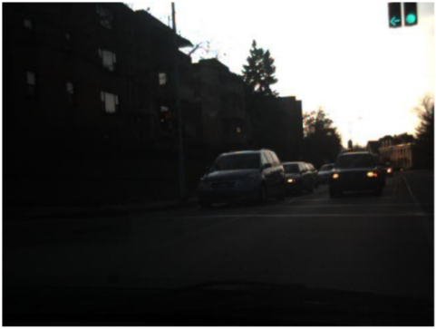


Challenging Environmental Conditions
Seasonal Variations in Nordland (Sunderhauf 2013)
SeqSLAM - Sunny Days vs Stormy Nights (Milford 2012)
Non-linear Intensity Deformation by Automatic Camera Settings (Alismail 2017)

Slide 9
Place Recognition – Summary
Local Image Features
Robust to viewpoint variations
Global Representations
Robust to appearance variations
Deep-learned features
Robust to both
Lack ability to estimate relative 3D pose for matches

Slide 10
Visual SLAM
Optimization
Visual Place Recognition
Visual Odometry
Representation Map

Slide 11
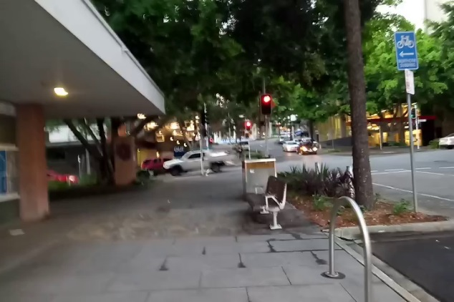
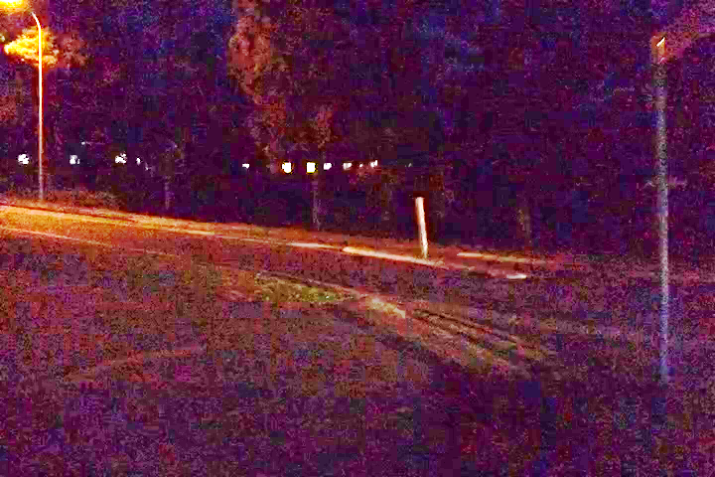

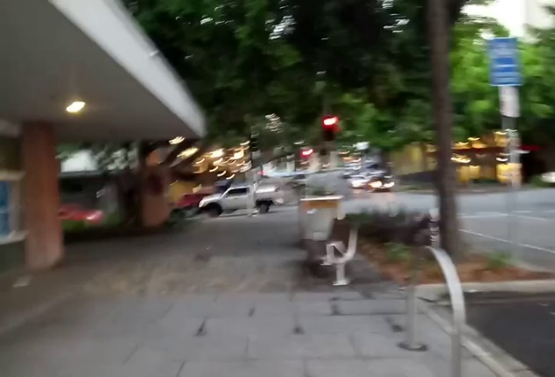
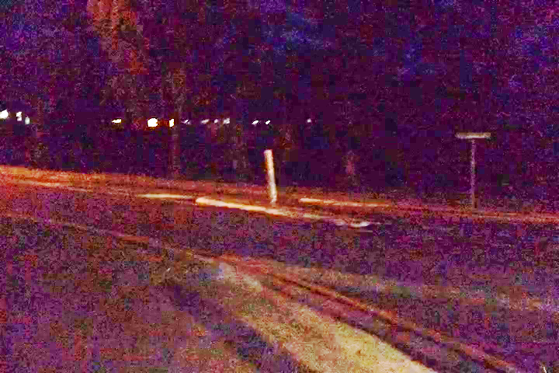
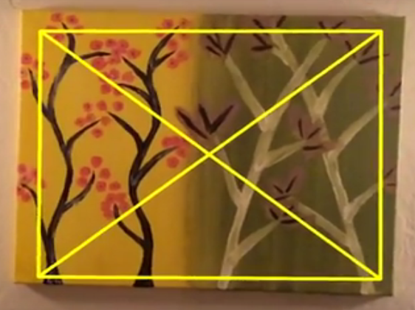
Visual Odometry
Matching consecutive images for Ego-motion estimation
Methods
Feature Correspondence
Direct Whole Image Matching
Hybrid Methods
Deep Learning Based
Challenges
Abrupt Appearance variations
Low light environment
Rapid Camera Motion
Motion Blur
VO Failure is catastrophic for Visual SLAM
(Alismail 2016)

Slide 12
Visual SLAM
Optimization
Visual Place Recognition
Visual Odometry
Representation Map

Slide 13
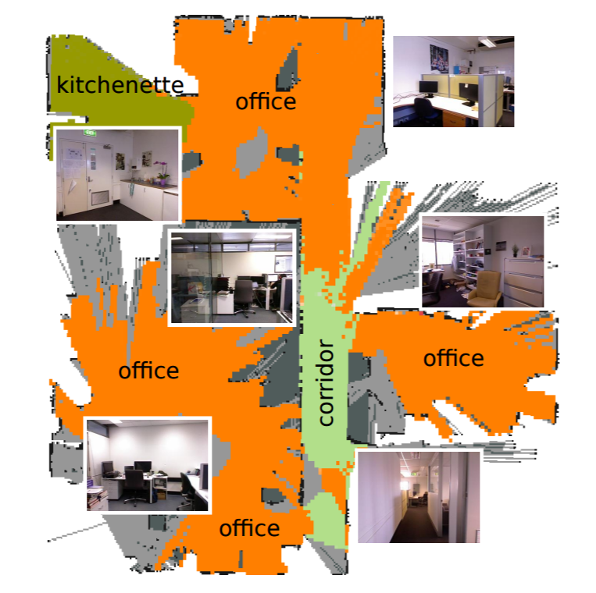

Representation Map
Types of Maps
Topological, Metric or Topometric
3-D Reconstruction of Environment
6-DoF Visual SLAM systems
Sparse, Semi-Dense or Dense Reconstruction
Semantics in Maps
Meaningful interaction with environment
Probabilistic Semi-Dense Mapping (Mur-Artal 2015)
Place Categorization and Semantic Mapping (Sunderhauf 2016)

Slide 14
Visual SLAM
Optimization
Visual Place Recognition
Visual Odometry
Semantics?
Representation Map

Slide 15
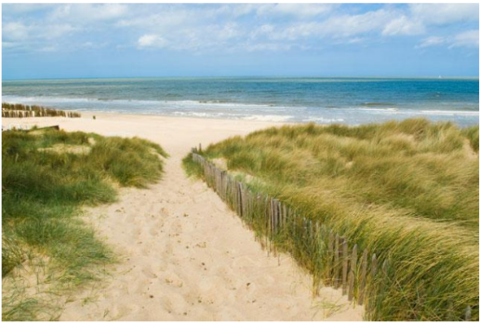
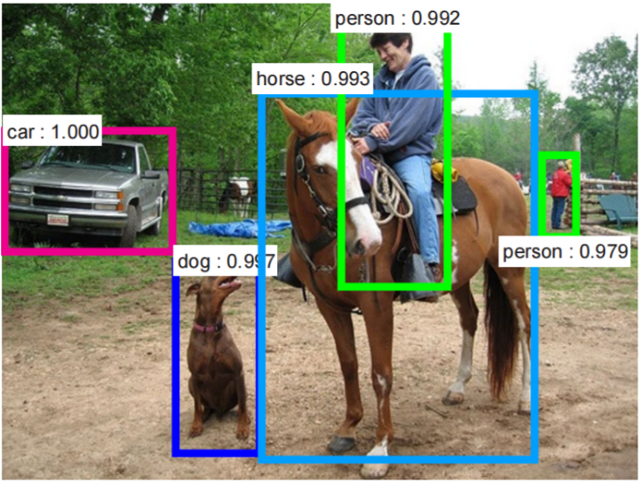
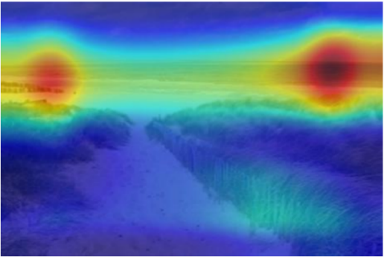
Semantics in Vision
Semantics within an Image
Object Recognition
Sparse or Dense Object Segmentation.
Place Semantics
Place-centric vs Object-centric
Place Categories and Attributes
Object Detection Using Faster R-CNN (Ren 2015)
Type of environment
outdoor
Semantic categories:
coast:0.35, ocean:0.30, boardwalk:0.07
(Zhou 2014)

Slide 16
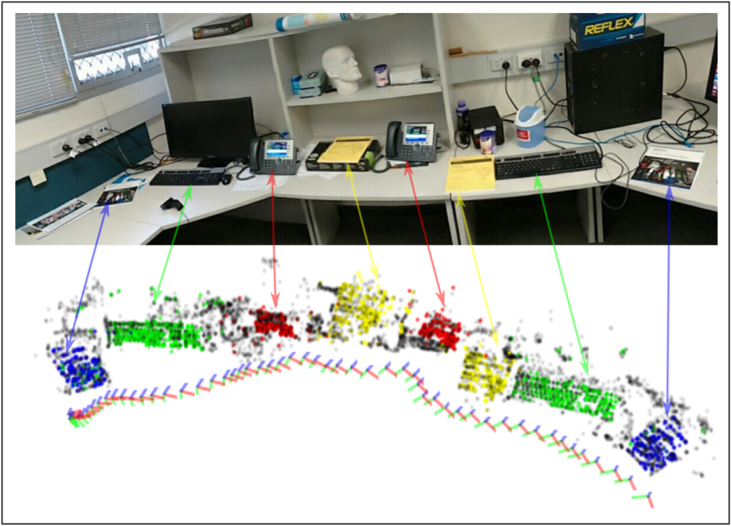
Semantics in Visual SLAM
Object-Oriented
Matching Object 3-D Models
Objects as Landmarks
Mostly Indoor
Place-Oriented
Semantic Mapping
Ideal Environmental Conditions
Multi-Object SLAM (Dharmasiri 2016)

Slide 17
Research Gap
Visual Place Recognition
Viewpoint- and Condition-Invariance
With 3D Relative Pose Estimation
Visual Odometry
Robustness to Dynamic Conditions
Hybrid Approach
Representation Map
Semantic Maps on top of Geometric Maps
Semantics for places
Use Semantics to improve place recognition

Slide 18
Problem Statement
How can we develop a general purpose
6-DoF semantics-aware viewpoint- and condition-invariant visual SLAM system?

Slide 19
Problem Statement
How can we develop a general purpose
6-DoF semantics-aware viewpoint- and condition-invariant visual SLAM system?

Slide 20
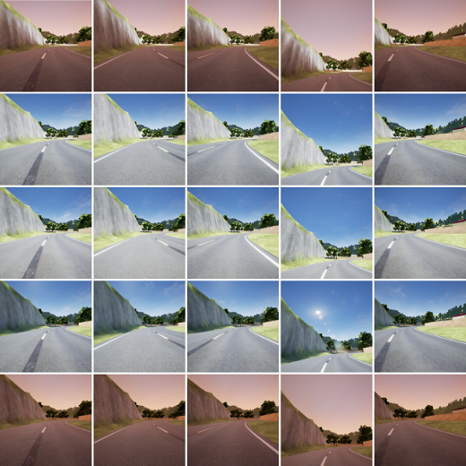
Characterizing System’s Response
viewpoint- and condition-invariant
Variations in Viewpoint and Environmental Conditions
Visual SLAM
Place Recognition
Visual Odometry
Performance Evaluation
Using Real and Simulated Data
(Skinner 2016)

Slide 21
Adapting to Challenging Conditions
viewpoint- and condition-invariant
Low Light, Rapid Movement, Variable Speed
Hybrid Visual Odometry
Using state-of-the-art VO with
Coarse Ego-motion Estimation for
Adapting System Parameters or
Backing up during failure
Improving Place Recognition Using Motion Cues

Slide 22
Problem Statement
How can we develop a general purpose
6-DoF semantics-aware viewpoint- and condition-invariant visual SLAM system?

Slide 23
Problem Statement
How can we develop a general purpose
6-DoF semantics-aware viewpoint- and condition-invariant visual SLAM system?

Slide 24
Semantic Segmentation of Environment
semantics-aware, condition-invariant
Planned Approach
Semantic Place Categorization
Temporal Clustering of Semantic Labels
Segment Environment
Office Space - Cubicles, Canteen, Corridor, Restroom etc.
Vehicle on Roads - Urban Canyon, Highway, Tunnel etc.
House – Bedroom, Kitchen, Lawn, Stairs etc.
Place Categorization and Semantic Mapping (Sunderhauf 2016)

Slide 25
Semantic Segmentation of Environment
semantics-aware, condition-invariant
Expected Outcome
Seamless Transitions Within Environment
Indoor/Outdoor, Naturally/Artificially Lit, Bland/Cluttered
Benchmark place recognition performance against state-of-the-art methods
Categorize and Recognize in a Reduced Search Space
Coarse Semantic Localization
Study Computational Gain and Performance Effects for very large databases

Slide 26
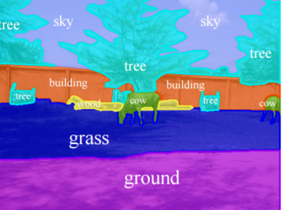
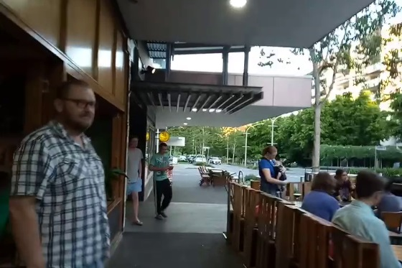
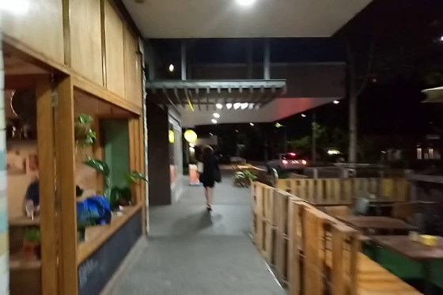
Semantic Segmentation Within Image
semantics-aware, condition-invariant
Planned Approach
Use state-of-the-art semantic segmentation
Object-level or Pixel-level
Learn semantically salient objects/regions for place recognition
Semantic Annotations (Mottaghi 2014)

Slide 27
Semantic Segmentation Within Image
semantics-aware, condition-invariant
Expected Outcome
Determine Condition-Dependent Objects/Regions
Determine Dynamic Objects
Evaluate Performance with Semantic Masking
Performance Benchmark for place recognition with
A large number of dynamic objects and
Extreme condition variations

Slide 28
Problem Statement
How can we develop a general purpose
6-DoF semantics-aware viewpoint- and condition-invariant visual SLAM system?

Slide 29
Problem Statement
How can we develop a general purpose
6-DoF semantics-aware viewpoint- and condition-invariant visual SLAM system?

Slide 30
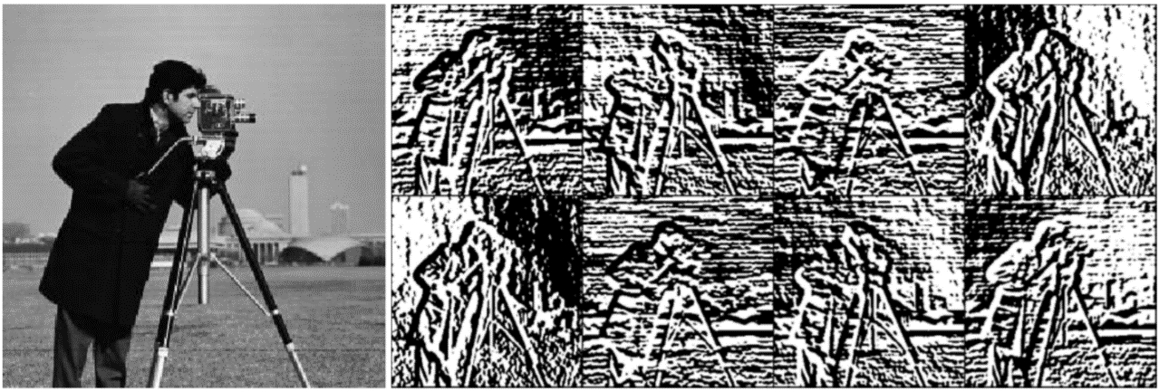
Appearance-Robust 3-D Relative Pose
6-DoF, condition-invariant
Planned Approach
Condition-Invariant Image Representation
Exploring Bit-Planes Descriptor (Alismail 2016)
Direct Image Alignment in LK framework
Descriptor Constancy vs Brightness Constancy
Expected Outcome
3D Relative Pose Estimation for Condition-Invariant Place Recognition
6-DoF Condition-Invariant Visual SLAM system
Benchmark Performance against state-of-the-art
8-Channel Bit-Plane Descriptor can be used within a multi-channel LK framework using SSD cost measure (Alismail 2016)

Slide 31
Problem Statement
How can we develop a general purpose
6-DoF semantics-aware viewpoint- and condition-invariant visual SLAM system?

Slide 32
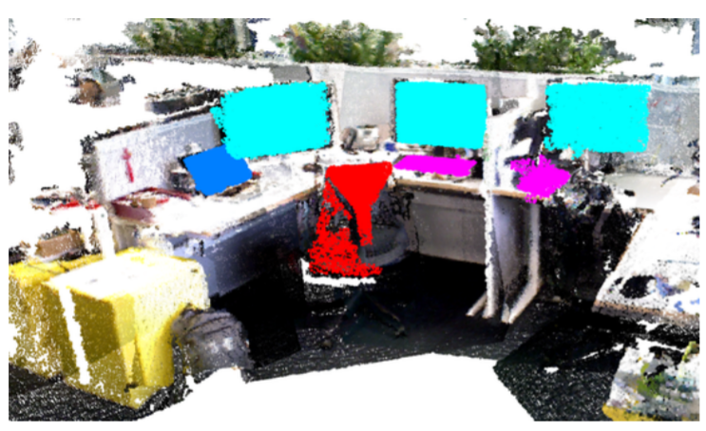
An Integrated System
6-DoF semantics-aware viewpoint- and condition-invariant visual SLAM system
Planned Approach
Semantic Mapping and System Integration
Hybrid Visual Odometry
Visual Place Recognition
Semantic Awareness
3-D Relative Pose for Loop Closures
Expected Outcome
3-D Semantically-Interactive Map of Environment
Semantic Navigation Goals
Object Oriented Semantic Mapping (Sunderhauf 2016)

Slide 33
Work Progress
Performance Evaluation using High-Fidelity Simulation
Place Recognition – SeqSLAM
Visual SLAM – ORB-SLAM
Adapting to Environment
Transitions within Environment
Improving Condition-Invariant Place Recognition
Ego-motion Estimation in Challenging Conditions
Hybrid Visual Odometry
Improving Place Recognition Using Motion Cues

Slide 34
Work Progress
Performance Evaluation using High-Fidelity Simulation
Place Recognition – SeqSLAM
Visual SLAM – ORB-SLAM
Adapting to Environment
Transitions within Environment
Improving Condition-Invariant Place Recognition
Ego-motion Estimation in Challenging Conditions
Hybrid Visual Odometry
Improving Place Recognition Using Motion Cues

Slide 35
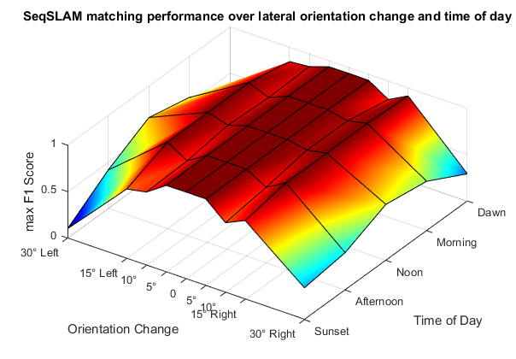
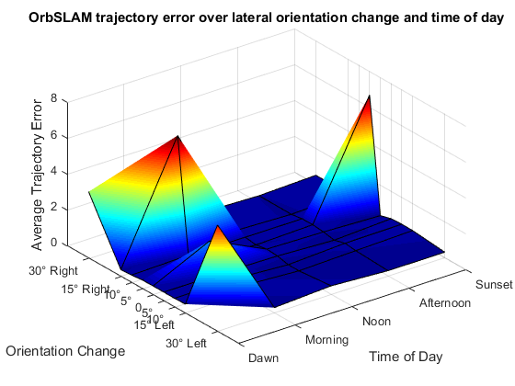
Characterizing Visual SLAM
Performance Evaluation Using High-Fidelity Simulation
Viewpoint Varies
Time of Day
SeqSLAM – Place Recognition
ORB-SLAM – Visual SLAM
(Skinner 2016)
Notes:
Varying time of day and viewpoint – data showing first image of different traversals
Top left is reference and rest are query datasets
Place Rec. performance , vSLAM is error
Takeaway is understanding sensitivity of systems using simulation data

Slide 36
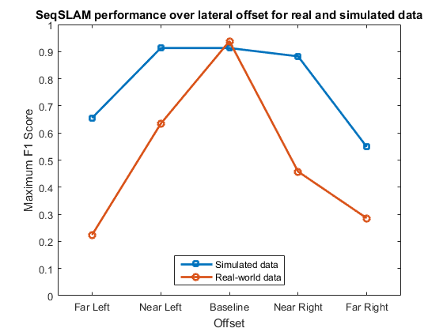
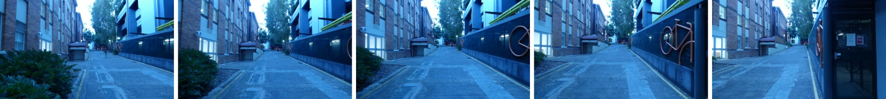
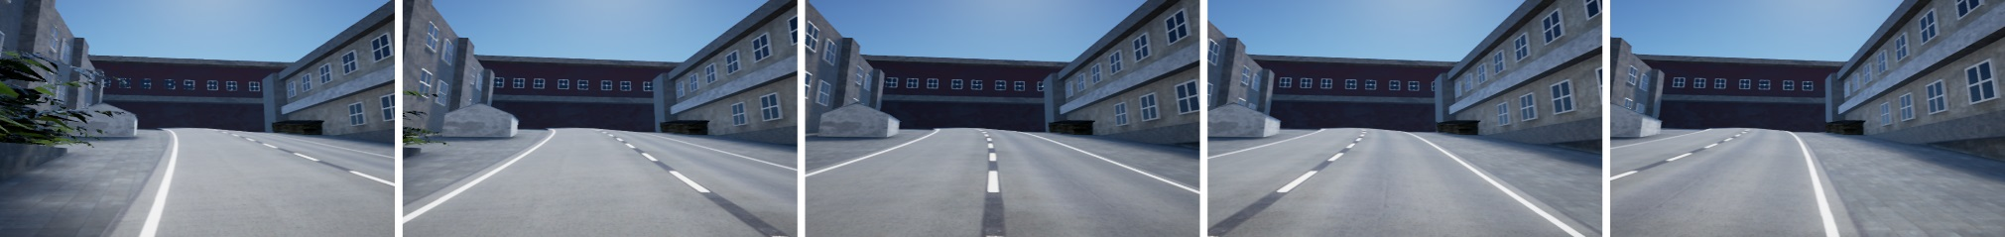
Performance Comparison
Real vs Simulated
Later Camera Offset
Real
Simulated

Slide 37
Accepted at IROS’16
High-fidelity simulation for evaluating robotic vision performance
Skinner, J., Garg, S., Sünderhauf, N., Corke, P., Upcroft, B. and Milford, M.

Slide 38
Work Progress
Performance Evaluation using High-Fidelity Simulation
Place Recognition – SeqSLAM
Visual SLAM – ORB-SLAM
Adapting to Environment
Transitions within Environment
Improving Condition-Invariant Place Recognition
Ego-motion Estimation in Challenging Conditions
Hybrid Visual Odometry
Improving Place Recognition Using Motion Cues

Slide 39
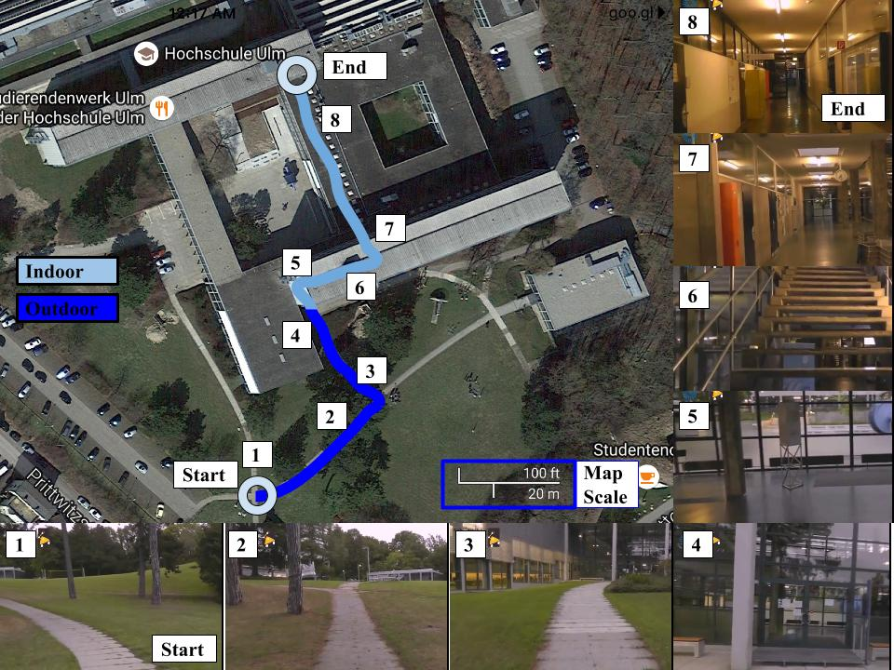
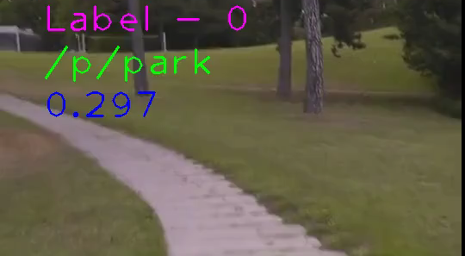
Adapting to Variations Within Environment
Semantic Place Categorization
Label
0 - Outdoor
2 - Indoor

Slide 40
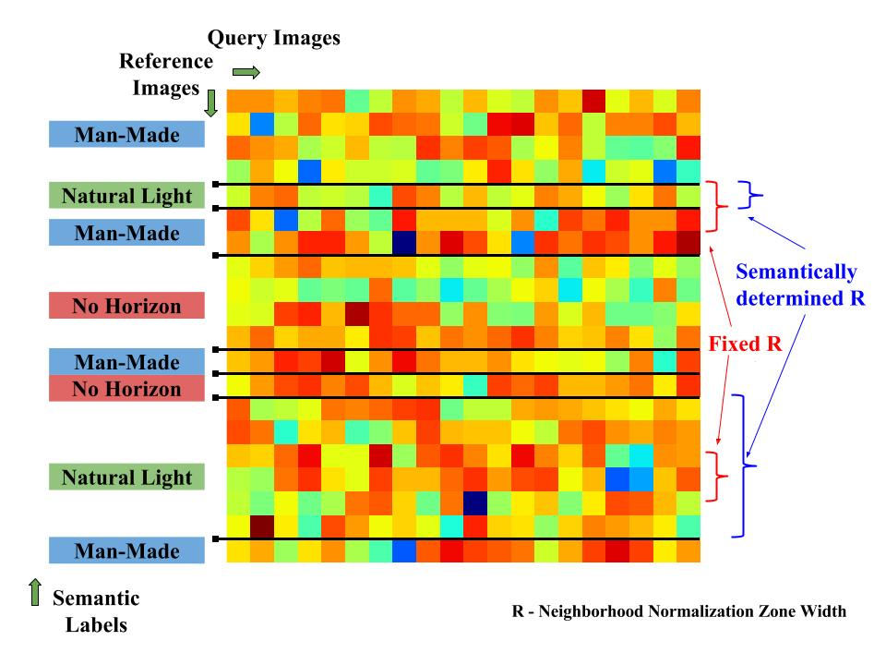

Slide 41
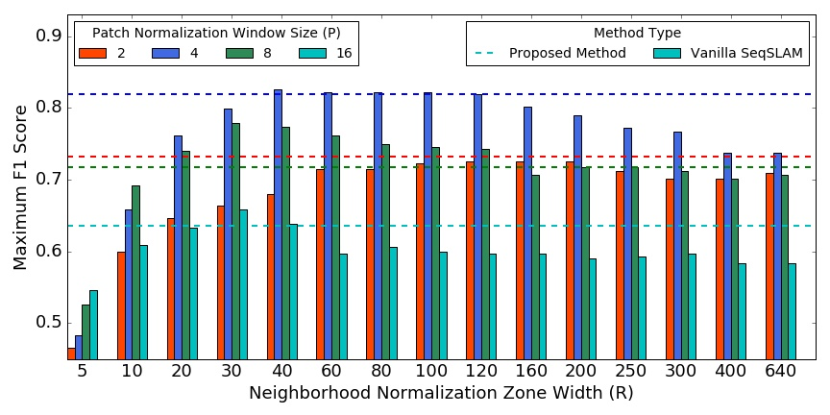
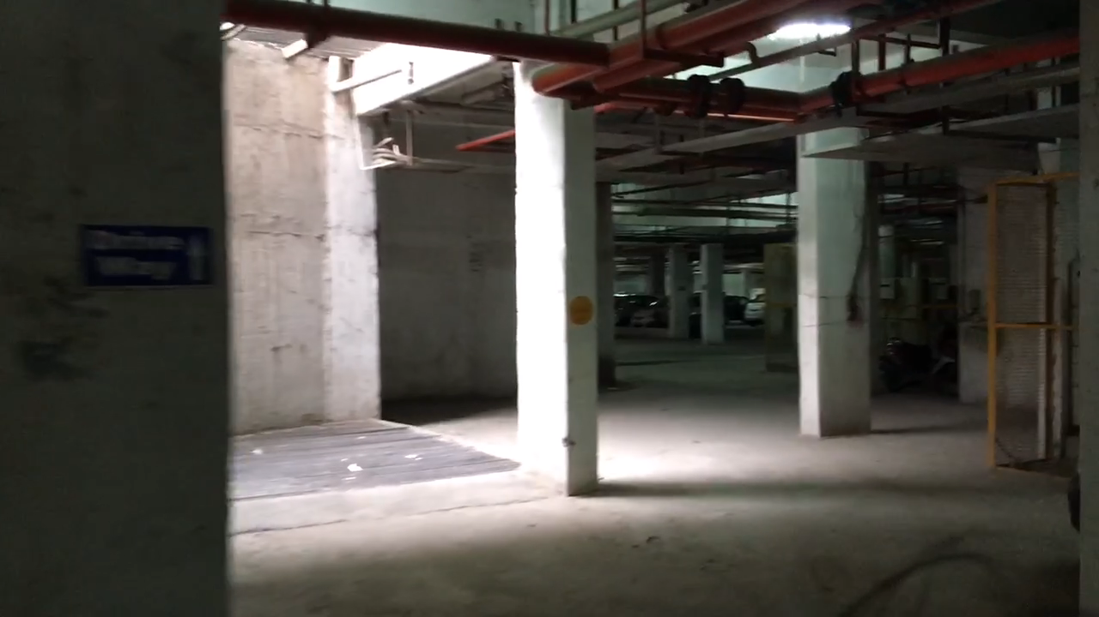
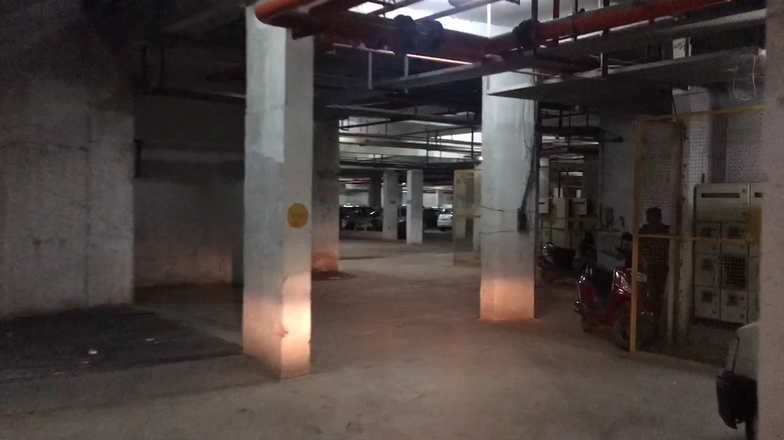
Parking Lot Data
From Basement to Open Parking
Day Traverse
Night Traverse

Slide 42
Accepted at IROS’17
Improving Condition- and Environment-Invariant Place Recognition with Semantic Place Categorization
Garg, S., Jacobson, A., Kumar, S. and Milford, M.

Slide 43
Work Progress
Performance Evaluation using High-Fidelity Simulation
Place Recognition – SeqSLAM
Visual SLAM – ORB-SLAM
Adapting to Environment
Transitions within Environment
Improving Condition-Invariant Place Recognition
Ego-motion Estimation in Challenging Conditions
Hybrid Visual Odometry
Improving Place Recognition Using Motion Cues

Slide 44
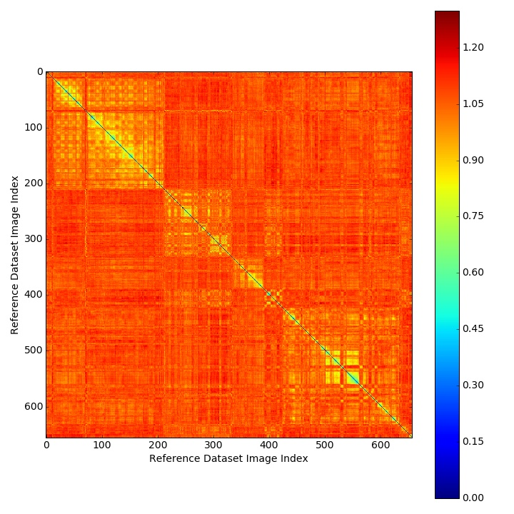
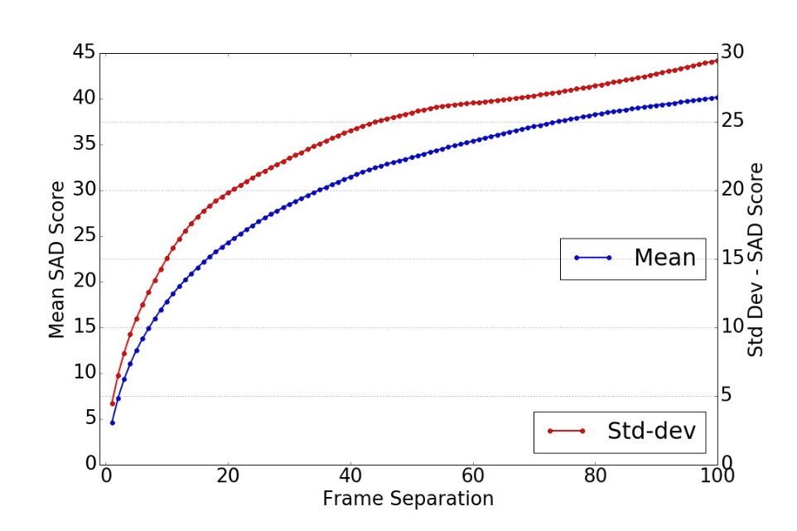
Ego-motion for Challenging Conditions
Self-Similarity Matrix

Slide 45
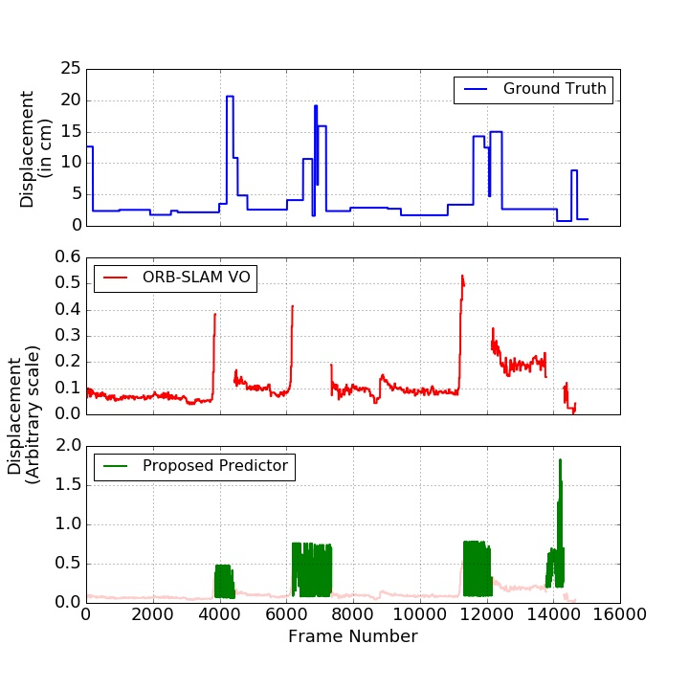
Challenges
Depends on Environment
Is 1-D
Planned Usage
Hybrid Visual Odometry System
Backup for Challenging Environmental Conditions
Adapting parameters for Rapid Motion

Slide 46
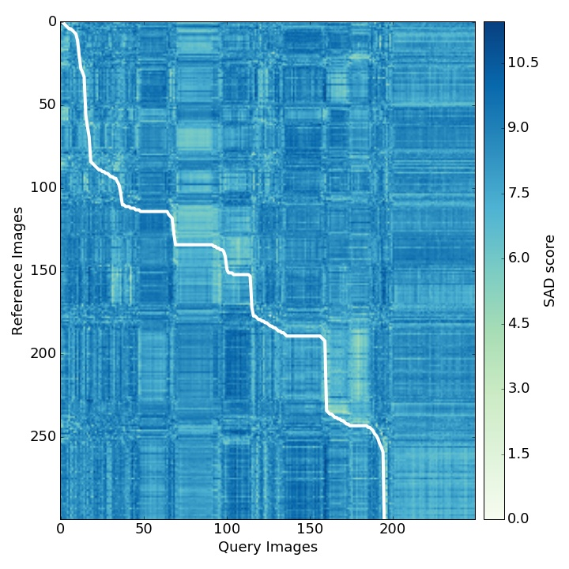
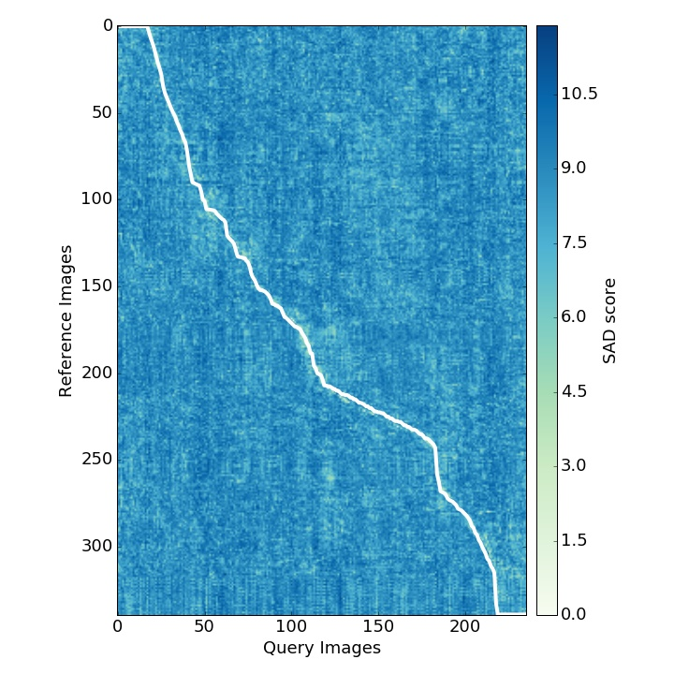
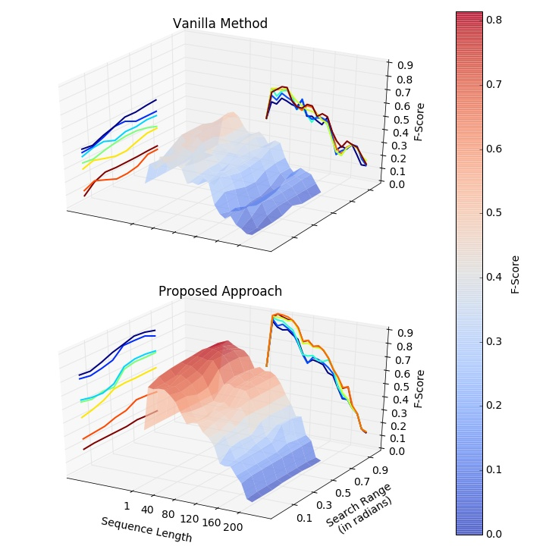

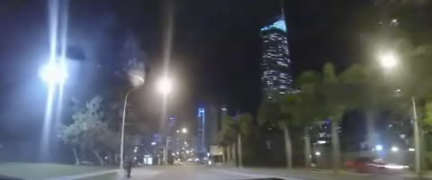
Improving Place Recognition Using Motion Cues
Dynamic Frame Sampling
Pick frames ‘n’ units apart
Vehicle Moving in Heavy Traffic Conditions
(Pepperell 2014)
Vanilla SeqSLAM
Proposed Method

Slide 47
Target Publications
Ego-motion Estimation for Low-Light and Rapid Camera Motion
ICRA’18
Semantic Segmentation of Environment
IROS’18
Semantic Segmentation Within an Image
ICRA’19
Appearance-Robust Relative 3-D Pose Estimation
IROS’19
6-DoF Semantics-Aware Visual SLAM
IJRR/TRO

Slide 48
PhD Timeline

Slide 49
References
Engel, Jakob, Thomas Schöps, and Daniel Cremers. "LSD-SLAM: Large-scale direct monocular SLAM." European Conference on Computer Vision. Springer International Publishing, 2014.
Sünderhauf, N., Neubert, P. and Protzel, P., 2013, May. Are we there yet? Challenging SeqSLAM on a 3000 km journey across all four seasons. In Proc. of Workshop on Long-Term Autonomy, IEEE International Conference on Robotics and Automation (ICRA) (p. 2013).
Alismail, H., Kaess, M., Browning, B. and Lucey, S., 2017. Direct Visual Odometry in Low Light Using Binary Descriptors. IEEE Robotics and Automation Letters, 2(2), pp.444-451.
Milford, M.J. and Wyeth, G.F., 2012, May. SeqSLAM: Visual route-based navigation for sunny summer days and stormy winter nights. In Robotics and Automation (ICRA), 2012 IEEE International Conference on (pp. 1643-1649). IEEE.
Cummins, M. and Newman, P., 2007, April. Probabilistic appearance based navigation and loop closing. In Robotics and automation, 2007 IEEE international conference on (pp. 2042-2048). IEEE.
Alismail, H., Browning, B. and Lucey, S., 2016, October. Robust tracking in low light and sudden illumination changes. In 3D Vision (3DV), 2016 Fourth International Conference on (pp. 389-398). IEEE.
Mur-Artal, R. and Tardós, J.D., 2015, July. Probabilistic Semi-Dense Mapping from Highly Accurate Feature-Based Monocular SLAM. In Robotics: Science and Systems.
Sünderhauf, N., Dayoub, F., McMahon, S., Talbot, B., Schulz, R., Corke, P., Wyeth, G., Upcroft, B. and Milford, M., 2016, May. Place categorization and semantic mapping on a mobile robot. In Robotics and Automation (ICRA), 2016 IEEE International Conference on (pp. 5729-5736). IEEE.

Slide 50
References
Ren, S., He, K., Girshick, R. and Sun, J., 2015. Faster r-cnn: Towards real-time object detection with region proposal networks. In Advances in neural information processing systems (pp. 91-99).
Zhou, B., Lapedriza, A., Xiao, J., Torralba, A. and Oliva, A., 2014. Learning deep features for scene recognition using places database. In Advances in neural information processing systems (pp. 487-495).
Laffont, P.Y., Ren, Z., Tao, X., Qian, C. and Hays, J., 2014. Transient attributes for high-level understanding and editing of outdoor scenes. ACM Transactions on Graphics (TOG), 33(4), p.149.
Dharmasiri, T., Lui, V. and Drummond, T., 2016, October. MO-SLAM: Multi object SLAM with run-time object discovery through duplicates. In Intelligent Robots and Systems (IROS), 2016 IEEE/RSJ International Conference on (pp. 1214-1221). IEEE.
Jia, Y., Shelhamer, E., Donahue, J., Karayev, S., Long, J., Girshick, R., Guadarrama, S. and Darrell, T., 2014, November. Caffe: Convolutional architecture for fast feature embedding. In Proceedings of the 22nd ACM international conference on Multimedia (pp. 675-678). ACM.
Sünderhauf, N., Pham, T.T., Latif, Y., Milford, M. and Reid, I., 2016. Meaningful Maps $-$ Object-Oriented Semantic Mapping. arXiv preprint arXiv:1609.07849.
Alismail, H., Browning, B. and Lucey, S., 2016. Bit-planes: Dense subpixel alignment of binary descriptors. arXiv preprint arXiv:1602.00307.
Skinner, J., Garg, S., Sünderhauf, N., Corke, P., Upcroft, B. and Milford, M., 2016, October. High-fidelity simulation for evaluating robotic vision performance. In Intelligent Robots and Systems (IROS), 2016 IEEE/RSJ International Conference on (pp. 2737-2744). IEEE.
Mottaghi, R., Chen, X., Liu, X., Cho, N.G., Lee, S.W., Fidler, S., Urtasun, R. and Yuille, A., 2014. The role of context for object detection and semantic segmentation in the wild. In Proceedings of the IEEE Conference on Computer Vision and Pattern Recognition (pp. 891-898).

Slide 51
Thank You!

Slide 52
Research Plan
Adapting Visual Odometry and Place Recognition
Characterizing Response to Condition and Viewpoint Variations
Coarse Ego-motion Estimation for Low Light and Rapid Movement
Semantics for Visual Place Recognition
Semantic Segmentation Across Places
Semantics Segmentation Within Places
6-DoF Semantics-Aware Visual SLAM
Appearance-Robust 3-D Relative Pose
An Integrated System

Slide 53
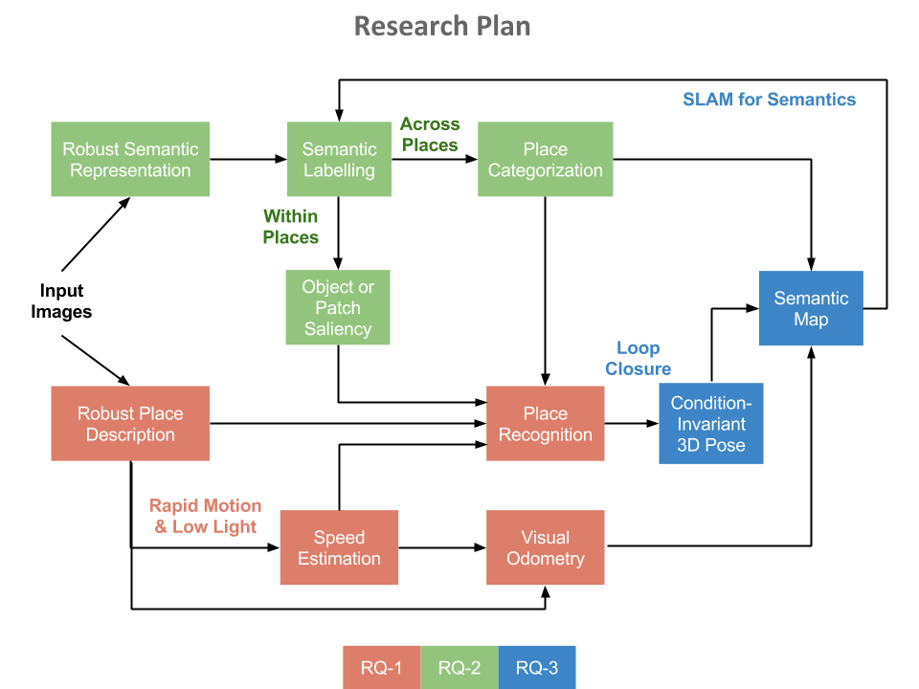

Slide 54
(Skinner 2016)

Slide 55
Some Challenges in Visual Odometry
Motion Blur
Low Light Environment
Illumination Variation
(Alismail 2016)

Slide 56
Probabilistic Semi-Dense Mapping (Mur-Artal 2015)
Place Categorization and Semantic Mapping (Sunderhauf 2016)

Slide 57
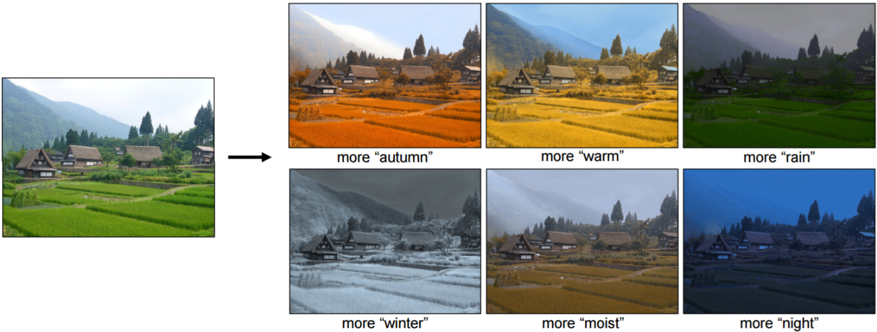
Object Detection Using Faster R-CNN (Ren 2015)
Multi-Object SLAM (Dharmasiri 2016)
Scene Recognition Using Places Database (Zhou 2014)
Transient Attributes for Outdoor Scene Editing (Laffront 2014)

Slide 58
Research Questions
How can we characterize a visual SLAM system’s response to variations in environment and ego-motion, and make it more robust?
How can visual semantic information improve the robustness and generality of visual place recognition?
How can we develop a 6-DoF semantics-aware SLAM system that is robust to condition and viewpoint variations?

Slide 59
Research Questions
How can we characterize a visual SLAM system’s response to variations in environment and ego-motion, and make it more robust?
How can visual semantic information improve the robustness and generality of visual place recognition?
How can we develop a 6-DoF semantics-aware SLAM system that is robust to condition and viewpoint variations?

Slide 60
Research Questions
How can we characterize a visual SLAM system’s response to variations in environment and ego-motion, and make it more robust?
How can visual semantic information improve the robustness and generality of visual place recognition?
How can we develop a 6-DoF semantics-aware SLAM system that is robust to condition and viewpoint variations?

Slide 61
Research Questions
How can we characterize a visual SLAM system’s response to variations in environment and ego-motion, and make it more robust?
How can visual semantic information improve the robustness and generality of visual place recognition?
How can we develop a 6-DoF semantics-aware SLAM system that is robust to condition and viewpoint variations?

